Slide 1




COVID-19 – GOVERNMENT WAGE SUBSIDY REQUIREMENTS

Slide 2

Presentation
Wage Subsidy Purpose
Key Aspects
Declaration
Information Required
Full-Time, Part-Time & Casual Employees
How to Apply
Managing Cash Flow

Slide 3
Wage Subsidy Purpose
To stretch jobs losses, avoiding economic collapse
To save as many businesses and jobs as possible
To ensure kiwi’s can continue to buy basic supplies to ride out the storm

Slide 4
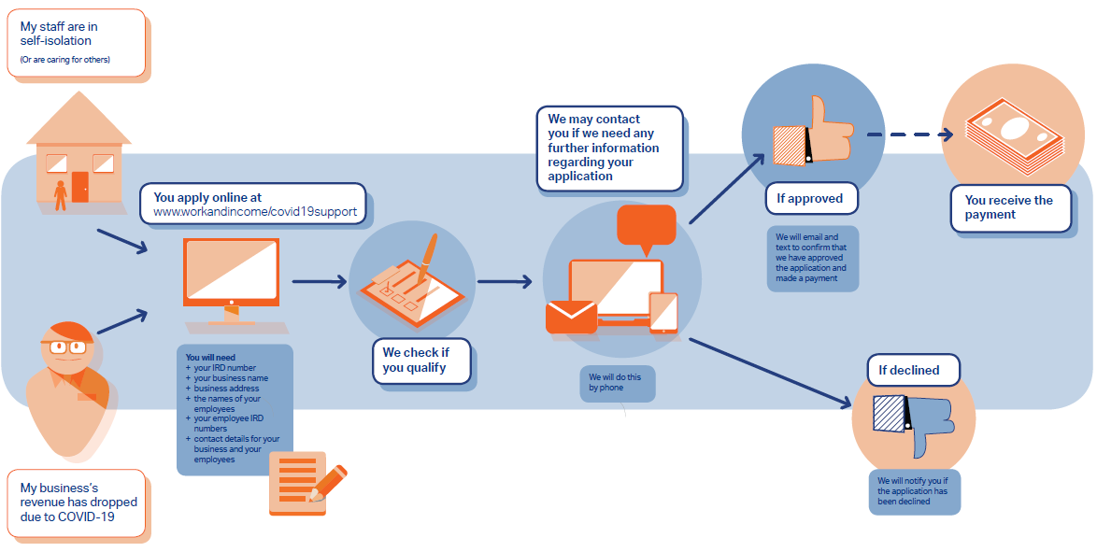

Slide 5
Wage Subsidy Purpose
To stretch jobs losses, avoiding economic collapse
To save as many businesses and jobs as possible
To ensure kiwi’s can continue to buy basic supplies to ride out the storm

Slide 6
Key Aspects
Business must be registered and operating in NZ (Sole traders must apply for NZ Business Number)
Businesses must experience or projected to experience a 30% decline in revenue in any given month (Jan to Jun 2020) when compared to previous year or previous month (if new business or start up).
Business must have taken steps to mitigate financial impact of COVID-19 (IE: Spoken to Bank, All Accounted For, etc)
Employees must be legally able to work in NZ

Slide 7

Key Aspects
$585.80 for employees working more than 20 hours per week (including shareholder employees)
$350 for employees working less than 20 hours per week
No clear guidance around staff with variable hours, but default position is average of last 4 weeks
Wage subsidy covers 12 weeks
Subsidy is paid as lump sum
Subsidy is only for wages/salaries to keep staff employed
Maximum subsidy threshold has been removed (23 March 2020, was $150,000

Slide 8
Declarations
Must have taken steps to mitigate financial impact of COVID-19 (IE: Spoken to Bank, All Accounted For, etc)
Must with “best endeavours” retain employees
Must commit to paying employees at least 80% of normal wages/salary for duration of subsidy
MSD must be notified if eligibility criteria changes and apply to repay if no longer eligible
Must obtain written consent from employees
Consent to MSD potentially sharing information
Confirm providing accurate information

Slide 9

Information Required
Business IRD Number (own IRD number if sole trader)
Business contact information
New Zealand Business Number (including for sole traders)
Names of Employees
Employees IRD numbers
Employees dates of birth
Hours normally paid to staff

Slide 10
Full-Time, Part-Time & Casual Employees
Full-Time – employees working 20 hours or more normal hours per week
Part-Time – employees working less than 20 hours
Casual – technically sit outside the scheme, however if can show pattern of regular hours and was intending to employee over next 12 weeks, then include within the application

Slide 11
Considerations
Staff that work term time, then have extended hours through holiday programmes
April 2020 holiday programmes not going ahead, hence no additional hours. Staff working through term should be paid at their normal term hours through that period.
IE: 10 hours per week, should be paid at least 8 hours per week.

Slide 12
Considerations
Casuals that work regular hours through term and planning to work through holiday’s, should include, but paid term hours. If no regular hours through term, literally casual, then would not be eligible for subsidy. Regardless of whether rosters prepared.
Recommendation for casual in this situation to apply to WINZ’s for assistance.
Contractor staff can apply for subsidy themselves, as would be eligible if 30% drop in their income.

Slide 13
How to Apply
For Employers
https://services.workandincome.govt.nz/ess/employer_applications/new
For Self Employed / Contractors
https://services.workandincome.govt.nz/ess/trader_applications/new

Slide 14
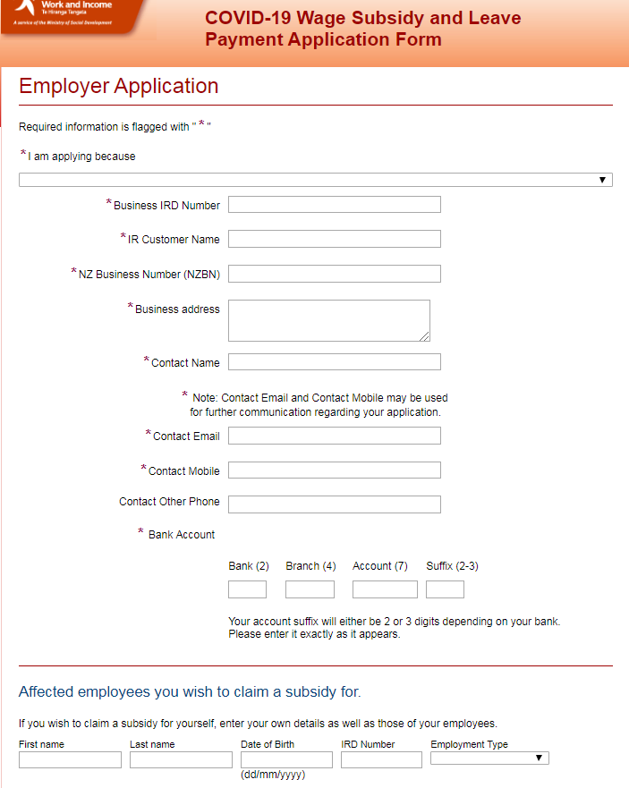

Slide 15
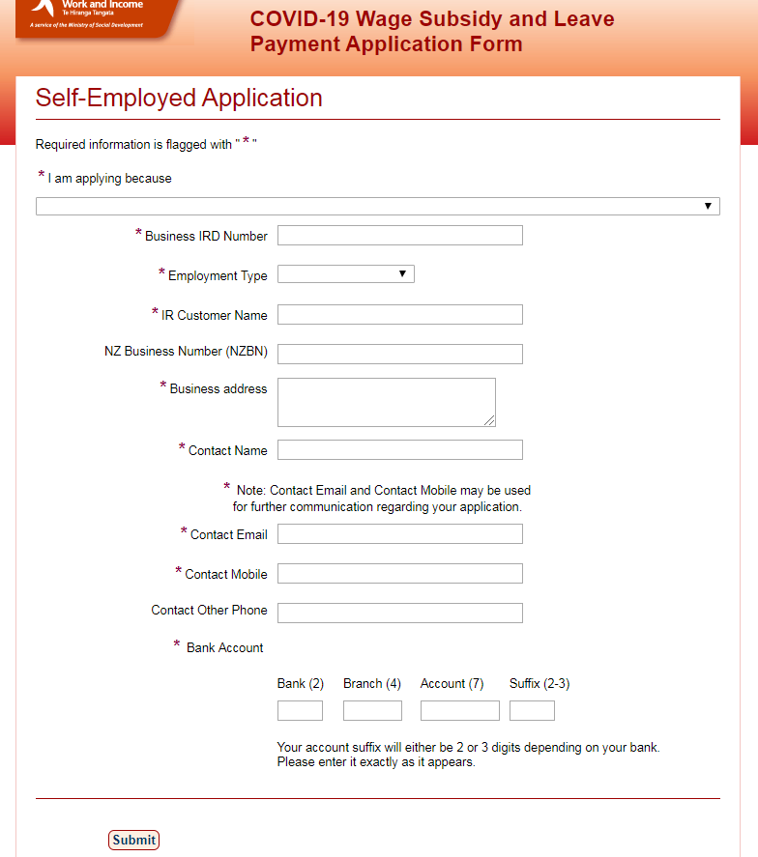

Slide 16
Other Considerations
Employees still paying, get them to help with updating procedures, programmes, marketing initiatives, product development, etc
Consulting with staff around future scenarios, particularly if lock down continues beyond 4 weeks.
Regular zoom / hangout meetings with staff to keep them informed
Xero Assistance Programme

Slide 17
Cash Flow Considerations
Calculations if paying staff 80% of normal wages, how much does the business need to top up. Potential offset with part-time.
If lockdown continues more than 4 weeks, can business avoid to continue paying staff. Consider restructures now, so if extended, ready to consult and make quick decisions.
Review all costs, what can you cull back over next 4-6 weeks. What is the least the business can operate on for 4-6 weeks.

Slide 18
Cash Flow Considerations
Funding Options
Flexi-facilities
Interest only / Mortgage repayment holidays / Breaking loans to secure lower interest rates / Extending terms of loans
Taxation - Holding on to Tax, instalment arrangements
Chasing up those outstanding invoices, credit card payments

